Slide 1
Towards a layer-3 data-center fabric with accelerated Linux E-VPN on the DPU
Roopa Prabhu, Rohith Basavaraja

Slide 2
Network Virtualization Architecture
EVPN VXLAN
CLOS network
E-VPN runs on TOR switches
spine layer
L3
leaf layer
L2
Layer 2 extension over Layer 3
Local anycast gateway
Multi tenant support
Fully interoperable (E-VPN, BGP, VxLAN)
Notes:
We do this with VxLAN-EVPN. This gives us Layer 2 extension over Layer 3, extending layer 2 where required, while also providing tenant isolation.
We get predictable traffic flows by using local anycast gateways. Every top of rack switch, in every rack, can act as the gateway for the local servers. This allows for the most optimal forwarding, no matter if it’s two servers in the same rack, or cross datacenter.
As mentioned, we can support multiple tenants through VRFs. This can prevent two tenants or security zones from ever communicating, even if they are located in the same rack. Just as VLANs were used to isolate traffic in the past, VRFs allow us to provide the same level of isolation at Layer 3.
We can keep an end of row firewall as the default gateway with Layer 2 extension or use the top of rack switch as the local anycast gateway, with the firewall as the router between security zones.
And finally, Cumulus Linux’s EVPN is fully interoperable. Supporting both VxLAN symmetric routing and asymmetric routing, we can interoperate with Arista, Cisco, Juniper or any one else that supports VxLAN routing.
Using VxLAN-EVPN over an eBGP underlay provides a nice, predictable network. Predictable traffic flows, predictable configurations and predictable operations no matter if it’s layer 2 or layer 3.

Slide 3




E-VPN implementation
Datacenter
Typically on the TOR switches
Accelerated by Switch ASIC datapath (nvidia, broadcom and others)
Most E-VPN control and datapath implementations are proprietary
L3 Underlay
BGP E-VPN
BGP E-VPN
BGP E-VPN
E-VPN HW datapath
leaf2
E-VPN HW datapath
leaf3
E-VPN HW datapath
VXLAN Tunnel
Hosts Rack1
Hosts Rack1
Hosts Rack3

Slide 4
Linux Open Software E-VPN implementation
BGP discovers local vlan-vni mapping via netlink
BGP reads local bridge <mac, vlan> entries and distributes them to bgp E-vpn peers
BGP learns remote <mac, vni> entries from E-VPN peers and installs them in the kernel bridge fdb table
Kernel bridge fdb table has all local and remote mac’s for forwarding
Spine
L3 Underlay
BGP
FRR BGP
FRRBGP
bridge
FRRBGP
bridge
bridge
Leaf1
swp1
vxlan-10 10.1.1.1
leaf2
swp1
vxlan-10 10.1.1.2
leaf3
swp1
vxlan-10 10.1.1.3
leaf1
Bridge learns local <mac, vlan> in its fdb
Host/VM 1
mac1, IP1 VLAN-10
Host/VM 2
mac2 IP2
VLAN-10
Host/VM 3
mac3, IP3
VLAN-10
VXLAN Tunnel
Hosts Rack1
Hosts Rack2
Hosts Rack3

Slide 5
Linux E-VPN implementation
Zoomed in
FRR E-VPN control plane talks to kernel via netlink
Local mac entries are stored in the bridge fdb tables
Remote mac entries are installed in the vxlan fdb table
Neighbour table is used to store remote mac-ip entries
Control plane added fdb and neigh entries are marked with NTF_EXT_LEARN flag
FRR routing and E-VPN controlplanee
user-space
kernel
bridge
neighbour
routing
vxlan
Bridge arp/nd suppression
vrf

Slide 6
Linux E-VPN implementation
Dataflows
Tenant-port
(switchport/container/guest port)
Tenant-port
(switchport/container/guest port)
Host/switch
Host/switch
ARM cores
FRR
FRR
Bridge
vni10
vni10
Bridge
vni20
vni20
vlan10
vlan20
vlan10
vlan20
vrf-red
vrf-blue
vrf-red
vrf-blue
l3vni
l3vni
l3vni
l3vni
p0
p1
p0
p1
underlay
Layer 2 communication, pink tenant
Layer 3 communication, pink tenant
Layer 2 communication, blue tenant
Layer 3 communication, blue tenant

Slide 7
Linux kernel E-VPN Hardware acceleration
Open, Closed implementations
Kernel E-VPN datapath implementation is closer to the switch ASIC E-VPN datapath
Natural choices of hardware acceleration are
  Switchdev driver
  Userspace switch sdk drivers (closed)
    Netlink to mirror kernel datapath software state into hardware
Netlink driver
FRR routing and E-VPN controlplane
user-space
kernel
bridge
neighbour
routing
vxlan
Bridge arp/nd suppression
vrf

Slide 8
Networking with DPU
DPU architecture
Host
  DPU (data processing unit) is a new piece in the data center disaggregation space
  DPU’s can offload, accelerate and isolate a broad range of advanced networking, storage, and security services
  Allows server processors to perform only compute tasks while the DPU handles data movement between networked compute and storage
Applications
Emulated devices
network services
DPU
Arm
applications
network services
Accelerated programmable data pipeline
Lookaside Hardware Accelerators
ASAP
PKA
G-DMA
crypto
RDMA
storage
Stream
Reg-Ex

Slide 9
DPU as a network infrastructure services platform
Host running only applications
Infrastructure services
Network Functions deployed as services on the DPU
DPU Network infrastructure services orchestrated via kubernetes
DPU network services chained using Service Function Chaining
Host
Applications containers
Kubernetes Application services control plane
Emulated devices
DPU
Arm
Software defined storage servuce
Software defined Security services
Software defined Network services
Kubernetes infrastructure services control plane
Accelerated programmable data pipeline
Lookaside Hardware Accelerators
ASAP
PKA
G-DMA
crypto
RDMA
storage
Stream
Reg-Ex

Slide 10
Building Virtualized datacenters with DPU and E-VPN
Moving Virtualization to the edge + Distributed control plane (E-VPN) on DPU
Moving towards a L3 Data Center Architecture
CLOS network
spine layer
L3
leaf layer
L2
DPU
DPU
DPU
DPU
DPU
DPU
Why E-VPN ?
Distributed, Scale-Out, Open standards based BGP control plane for the overlay​
Separates Data plane from Control plane – supports multiple Data planes: VxLAN, Nvgre​
Interoperable​
Simplified BGP for datacenter operations – unnumbered interfaces, auto-BGP​
Why E-VPN on DPU ?
Virtualization at the Edge with HW acceleration​
Simplified uniform L3 data center fabric​
L3 ECMP to the fabric, No MLAG​, No L2 protocol complexity, no loops​
Plug and Play connectivity between switch and fabric using BGP unnumbered​
Better integrated Edge and Network fabric solutions​
DPU provides a better platform for E-VPN deployment isolated from the host stack

Slide 11


BGP E-VPN on DPU
A distributed virtualization control plane at the Edge
FRR BGP E-VPN based virtualization control plane running on the DPU arm cores
VTEP (VxLAN tunnel end point) on DPU: Initiate and terminate VxLAN overlay
Simplified uniform L3 data center fabric​
  L3 ECMP to the fabric, No MLAG​, No L2 protocol complexity, no loops​
  Plug and Play connectivity between DPU and fabric using BGP unnumbered​
L3 routing
L3 ecmp
L3 ecmp
DPU
Vtep
BGP
DPU
Vtep
BGP
L3 routing
Vtep
BGP
DPU
DPU
Vtep
BGP
Bare Metal server
Bare Metal server
Bare Metal server
Bare Metal server

Slide 12
Deployment Models

Slide 13
BGP E-VPN Host and DPU
Deployment1 - trunk port
Tenant traffic from host is tagged
vlan-vni-map {
vlan10:vni10,
vlan20:vni20
}
bridge/ovs on host is not offloaded
Same tenant on the same host don't go through dpu
Same tenant on separate hosts go via the dpu and vxlan
Host
vlan20
vlan10
vlan10
bridge/ovs
PF0_host_rep1
ARM cores
PF0_rep1
FRR
Bridge
vni10
vni20
vlan10
vlan20
Layer 2 communication, pink tenant
vrf-red
vrf-blue
Layer 3 communication, pink tenant
Layer 2 communication, blue tenant
Layer 3 communication, blue tenant
l3vni
l3vni
p0
p1

Slide 14
BGP E-VPN Host and DPU
Deployment2 - sriov
Tenant traffic from host is un-tagged
DPU VF-vlan-vni-map {
VF1:vlan10:vni10,
VF2:vlan10:vni10
VF3:vlan20:vni20
}
No bridge/ovs on the host
Same tenant on the same host goes through the dpu
Same tenant on separate hosts go via the dpu and vxlan
Host
VF1
VF2
VF3
ARM cores
PF0_rep1
FRR
Bridge
vni10
vni20
vlan10
vlan20
Layer 2 communication, pink tenant
vrf-red
vrf-blue
Layer 3 communication, pink tenant
Layer 2 communication, blue tenant
Layer 3 communication, blue tenant
l3vni
l3vni
p0
p1

Slide 15
BGP E-VPN on DPU
VxLAN overlay network flows
Host
Host
vlan10
vlan20
vlan10
vlan20
bridge/ovs
bridge/ovs
PF0_host_rep1
PF0_host_rep1
ARM cores
PF0_rep1
ARM cores
PF0_rep1
FRR
Connect-X
Connect-X
FRR
Bridge
vni10
vni10
Bridge
vni20
vni20
eswitch
vlan10
vlan20
vlan10
vlan20
eswitch
vrf-red
vrf-blue
vrf-red
vrf-blue
p0
p1
l3vni
l3vni
p0
p1
p0
p1
l3vni
l3vni
p0
p1
underlay
Layer 2 communication, pink tenant
Layer 3 communication, pink tenant
Layer 2 communication, blue tenant
Layer 3 communication, blue tenant

Slide 16
Hardware Acceleration

Slide 17
Hardware acceleration on DPU
Flow tables
DPU hardware flow table initialization for E-VPN
Maintain netlink cache of Kernel E-VPN datapath objects (bridge and vxlan fdb, neighbour, routes, vrf)
Translate Kernel Datapath from netlink cache to flow table via netlink
Netlink cache
FRR
Netlink driver
kernel
DPU flow table

Slide 18
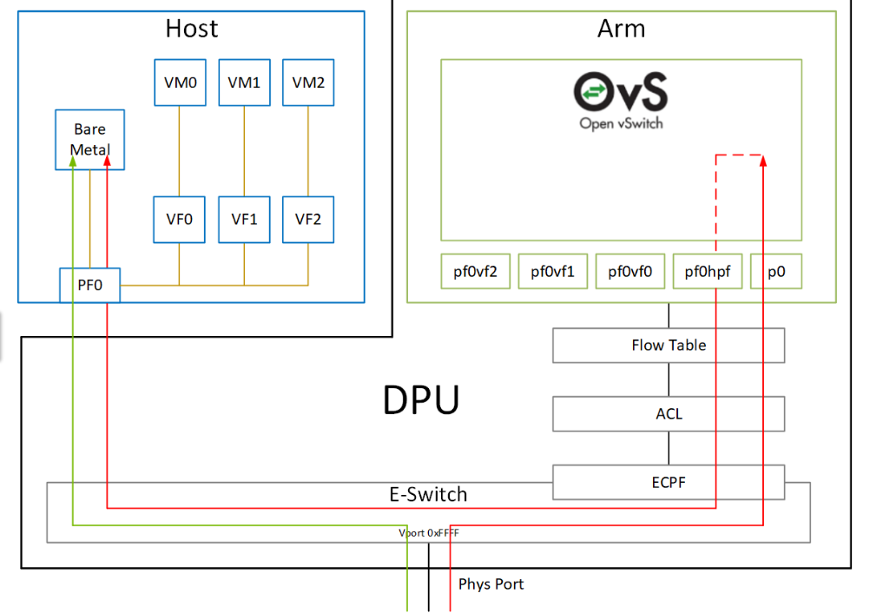
DPU representors and host PCI functions
The mapping
Linux kernel E-VPN datapath

Slide 19
E-VPN Netlink offload overview
Using TC Flower
userspace
FRR
IFUPDOWN2/network configurator
netlink
offload
driver
tc flower
INT
Vlan, Bond, SVI
FIB
FDB
VxLAN
NH
kernel
netlink
tc flower
netlink
drivers
mlx5
Connect-x
NIC

Slide 20
Netlink offload driver
Flow table mapping in netlink to flow driver
netlink
offload
driver
netlink dbs
INT
Vlan, Bond, SVI
FIB
FDB
VxLAN
NH
resolve l2, l3, nh and tunnels
resolved
entries
resolved l2 entries
resolved l3 entries
tc flower
xlate
translate to tc flower rules
l2 tc flower rules and actions
l3 tc flower rules and actions
netlink
kernel (tc flower)
mlx5 (sw steering)
Connect-x groups/matcher/actions (STEs)

Slide 21
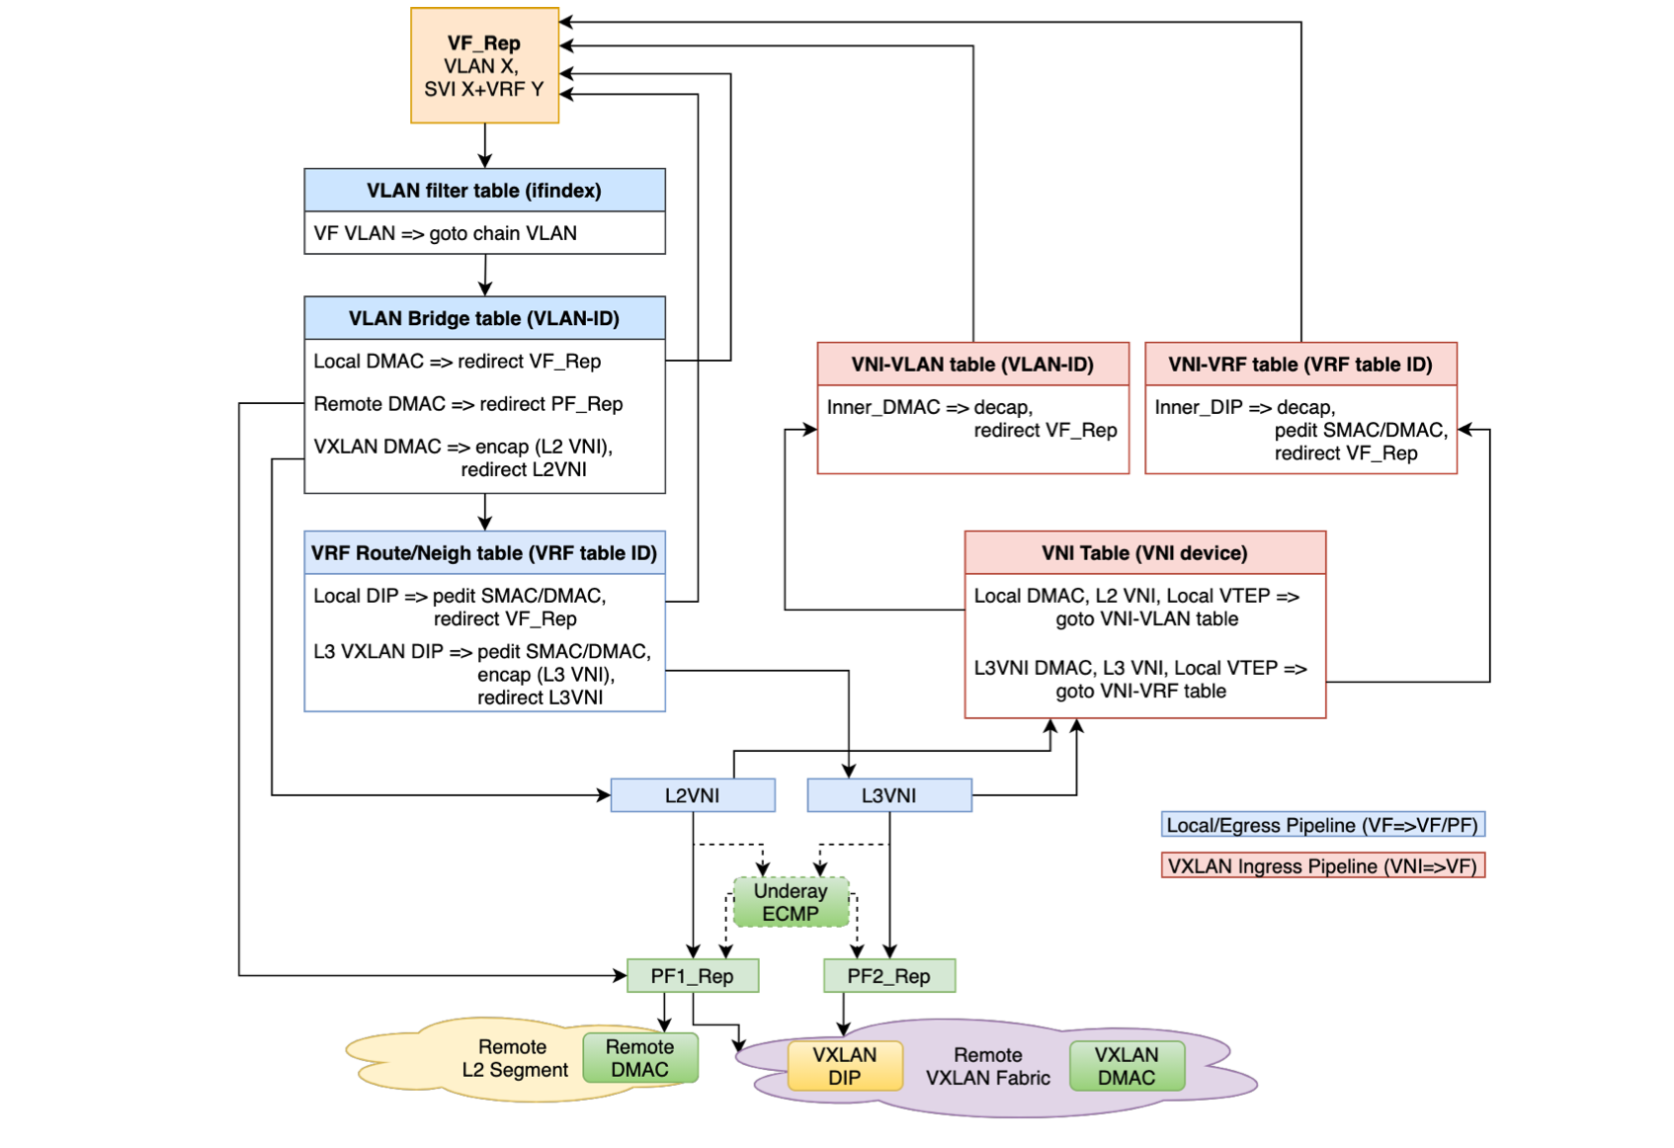
Netlink offload driver
Flow tables

Slide 22
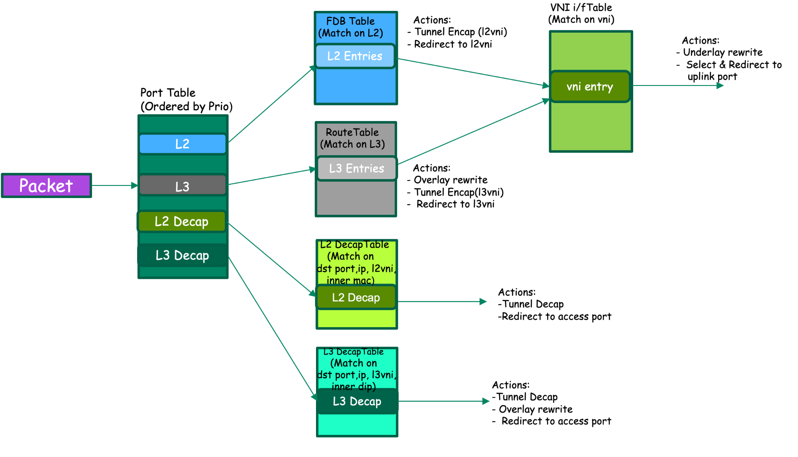
Netlink offload driver
Optimized HW Flow table lookup

Slide 23
Forwarding Tables Summary
Table Type | Match | Per Bridge port | Per L2 VNI | Per L3VNI | #Pref | Actions
FDB (for l2 fwd) | Incoming interface Dst Mac | Yes | No | No | 1 | Tunnel set (in case of Vxlan Briding Egress Redirect
L2 Vxlan Decap | Dest VTEP IP Dst port L2 VNI ID Overlay Dst MAC | No | Yes | No | 1 | Tunnel unset Egress Redirect
Route Table(with vrf support) | Incoming interface Eth type Dst IP | Yes | No | No | Multiple (only for supporting LPM) | Pedit (l2 rewrite) Tunnel set (in case of VxLAN symmetric routing) Egress Redirect
L3 Vxlan Decap(with vrf support) | Dest VTEP IP Dst port L3 VNI ID Overlay Dst IP | No | No | Yes | Multiple (only for supporting LPM) | Tunnel unset Pedit (l2 rewrite) Egress Redirect

Slide 24
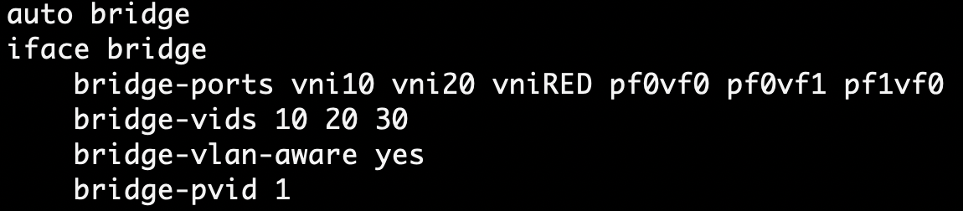
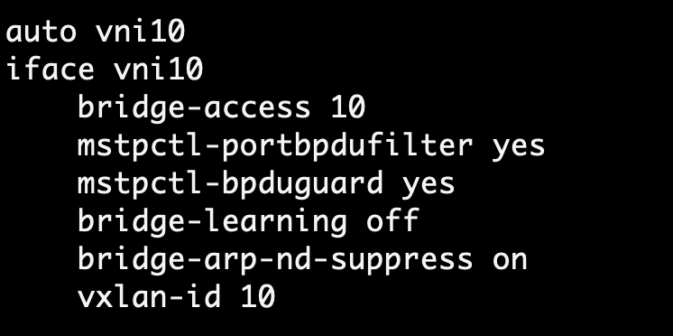
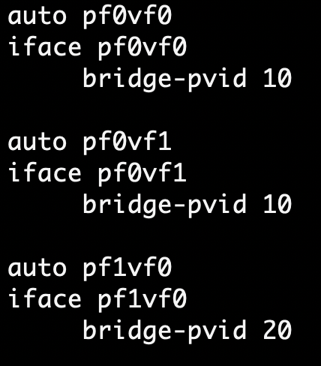
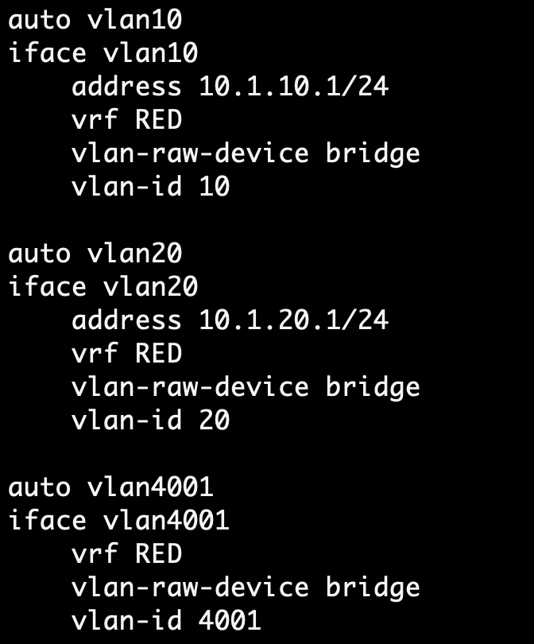
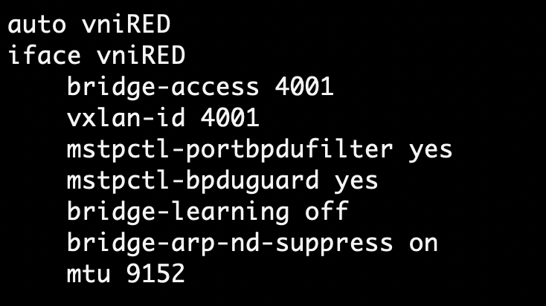
Netlink offload driver sample offload entries
Sample config
#Bridge
#L2 VNI
#Bridge Ports
#SVIs
#L3 VNI
Notes:
‹#›

Slide 25
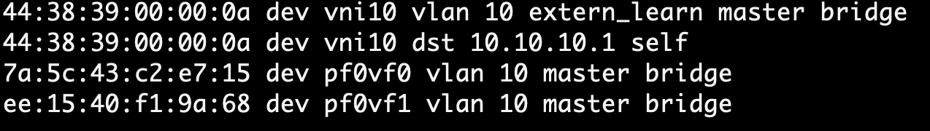
Netlink offload driver sample offload entries
EVPN bridging entries
#FDB Entries
Notes:
‹#›

Slide 26
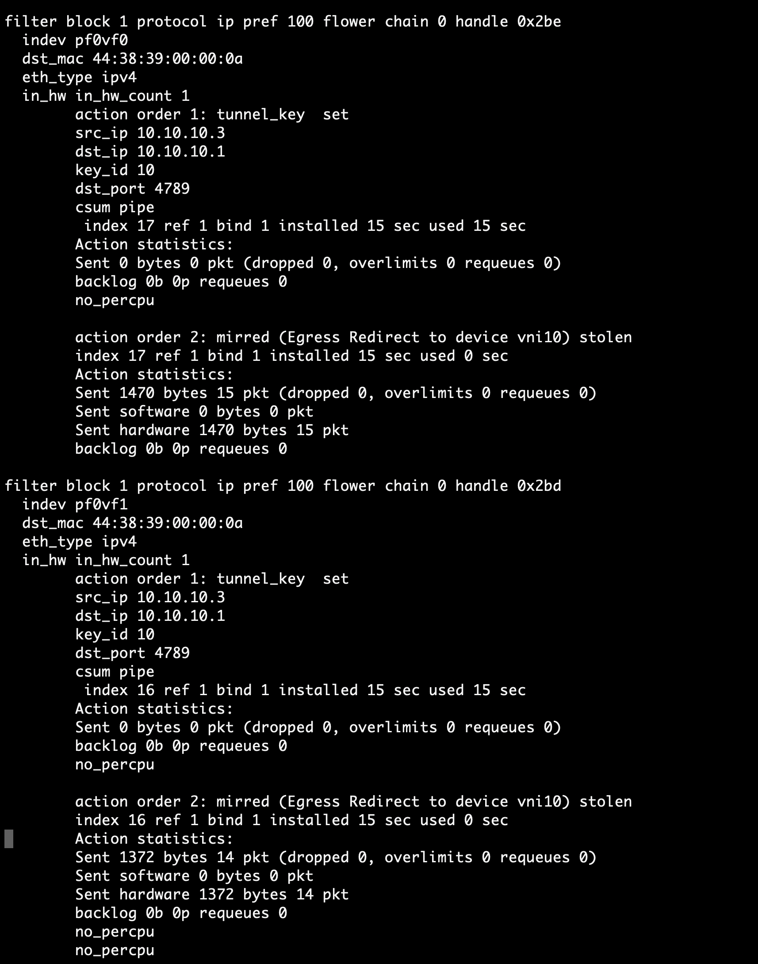
netlink offload driver sample offload entries :
Resulting TC entries
Encap/Tx Direction
Notes:
‹#›

Slide 27
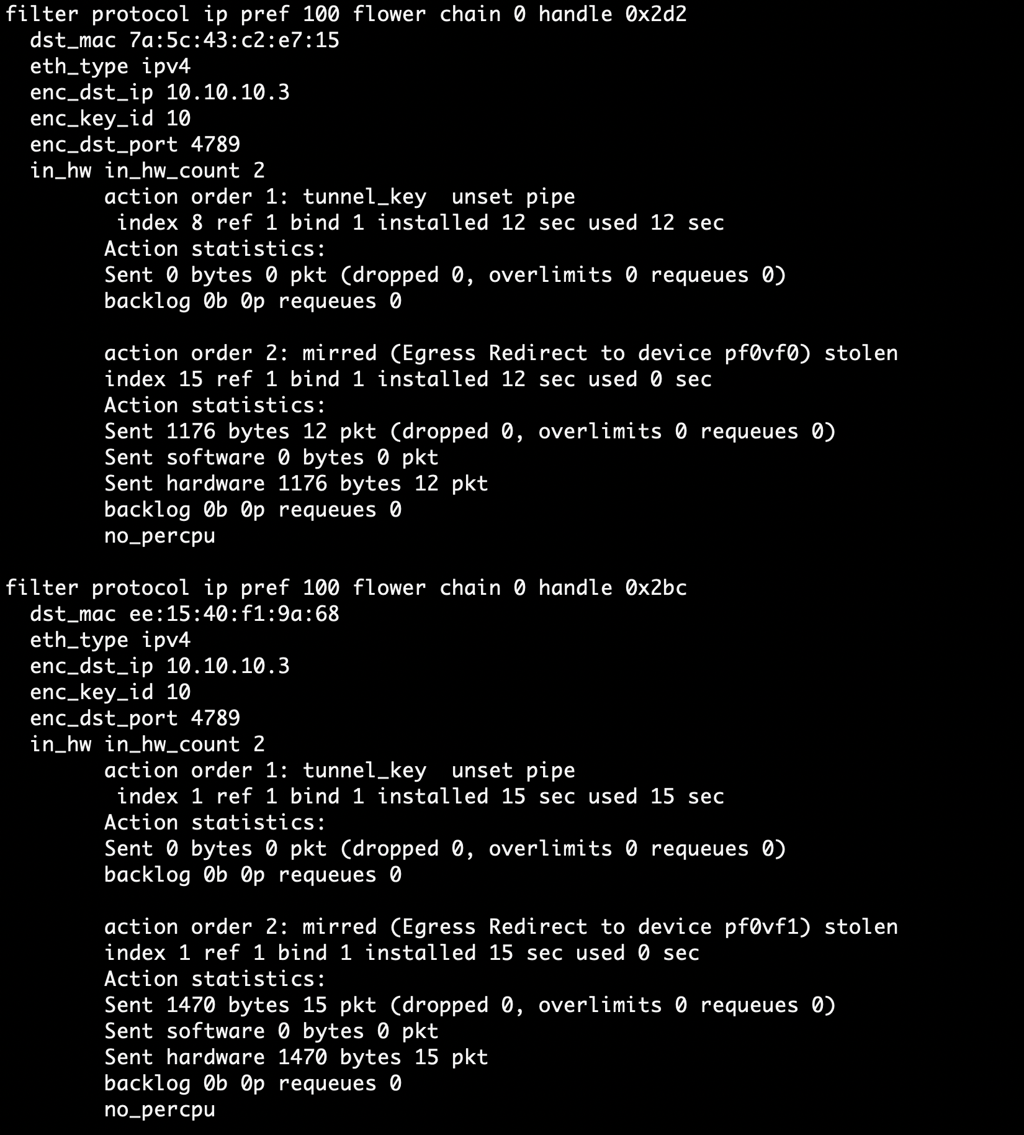
netlink offload driver sample offload entries :
Resulting TC entries
Decap/Rx Direction
Notes:
‹#›

Slide 28
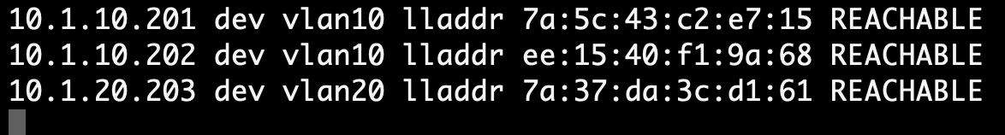
netlink offload driver sample offload entries :
EVPN Route Entries
#EVPN Routes
#Neigh entries
Notes:
‹#›

Slide 29
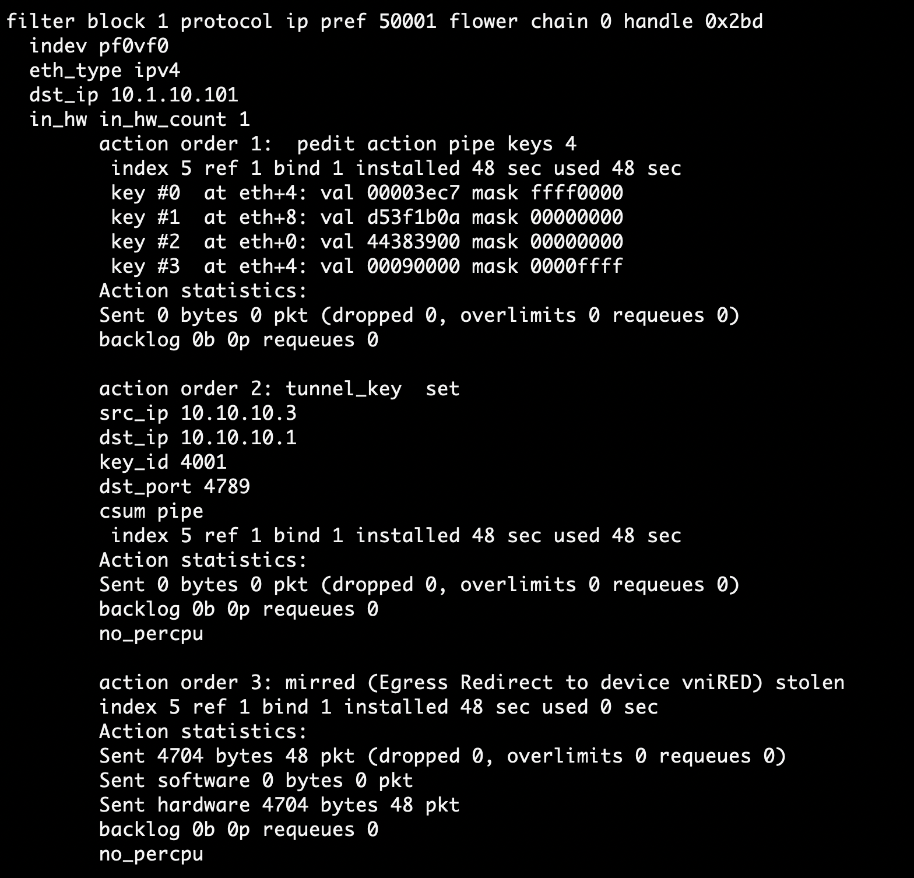
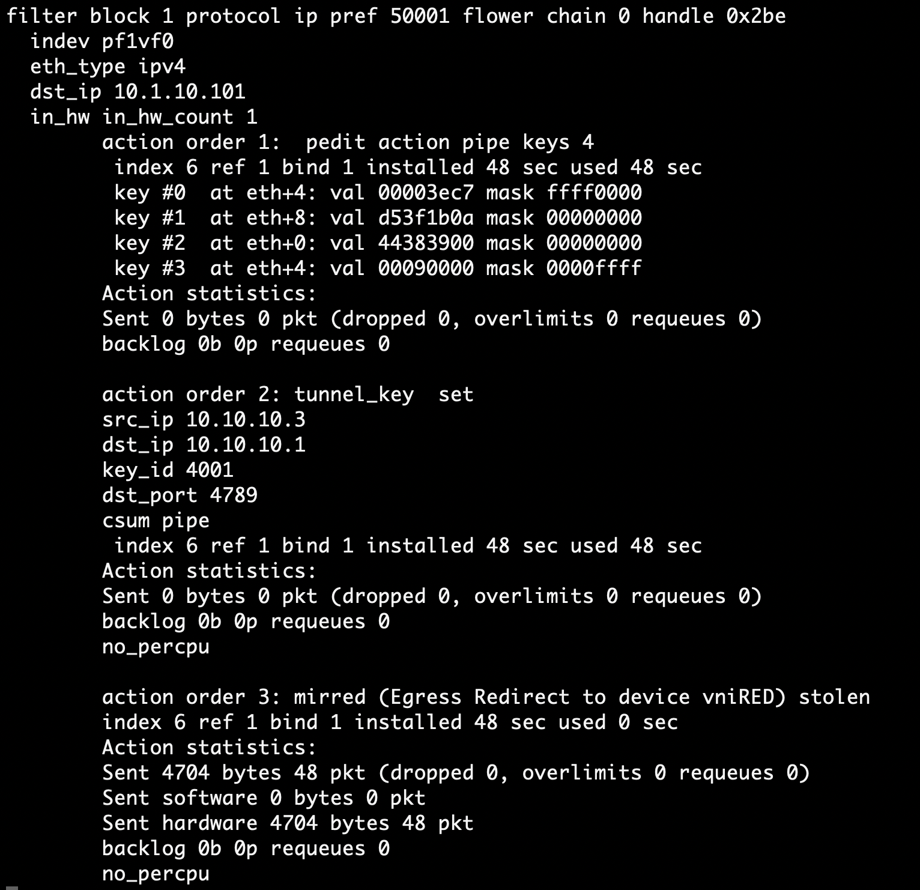
netlink offload driver sample offload entries :
Resulting TC entries
Encap/Tx Direction
Notes:
‹#›

Slide 30
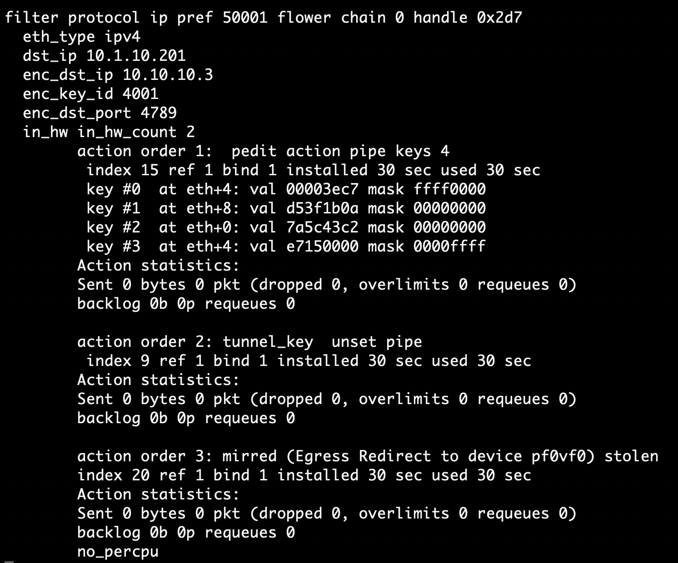
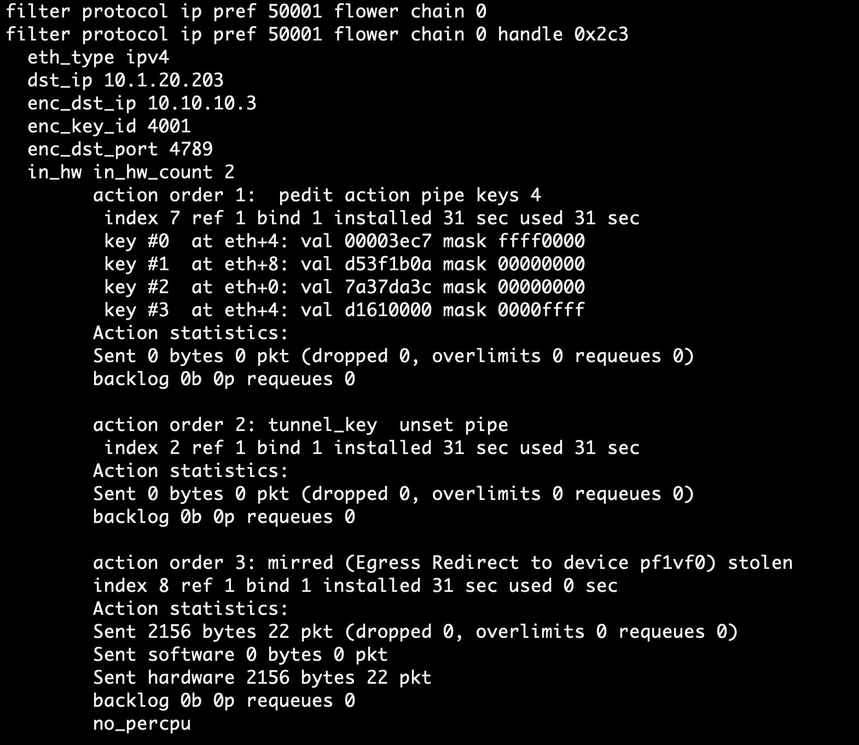
netlink offload driver sample offload entries :
Resulting TC entries
Decap/Rx Direction
Notes:
‹#›

Slide 31
Acknowledgements
Others who have or continue to work on the project ..
Andy Roulin
Alexander Petrovskiy
FRR team
Nvidia Networking Arch team
And many others..

